Slide 1
Sui Course 2023 / Part 6-2

Slide 2
Heterogeneous Collection

Slide 3
Agenda
Introduction to Heterogeneous Collection
The Bag Type
Example

Slide 4
Introduction to Heterogeneous Collection

Slide 5
Utilizing Heterogeneous Collections in Sui
In Sui, heterogeneous collections are essential when dealing with objects of varying types or when the types of objects are unknown at compile time.
A prime example of such a heterogeneous collection in Sui is the Bag type
Notes:
In Sui, heterogeneous collections are essential when dealing with objects of varying types or when the types of objects are unknown at compile time. Homogeneous collections like Vector and Table are suitable for applications where a collection of objects of the same type is needed, such as certain types of marketplaces. However, in cases where the marketplace or application needs to handle objects of different types or where the types of objects aren't known at compile time, a heterogeneous collection is needed.
A prime example of such a heterogeneous collection in Sui is the Bag type. This collection is similar to Table in that its keys and values are not stored within the Bag value, but instead are stored using Sui's object system. The Bag struct acts only as a handle into the object system to retrieve those keys and values. The Bag type allows for the storage and management of objects of varying types within the same collection, making it versatile and adaptable for various use cases.

Slide 6
The bag type

Slide 7
What is a bag
A Bag is a heterogeneous map-like collection in Sui, similar to Table, but can hold key-value pairs of different types.
Notes:
A Bag is a heterogeneous map-like collection in Sui, similar to Table, but can hold key-value pairs of different types.

Slide 8
How it works
A Bag is a heterogeneous map-like collection in Sui, similar to Table, but can hold key-value pairs of different types.
Notes:
Keys and values are not stored within the Bag value, but are stored using Sui's object system. The Bag struct acts as a handle into the object system to retrieve those keys and values.

Slide 9
Bag Comparison: Bag vs Table
 | Name | Bag | Table
 | Homogeneity vs. Heterogeneity | Bag is a heterogeneous collection, meaning it can hold objects of different types, or objects of types that are not known at compile time. This makes it more flexible for applications where the types of objects can vary​ | Table is a homogeneous collection, which means all keys and all values in a Table must be of the same type​
 | Type Specification | when creating a Bag, you do not need to declare any types upfront. The types of the key-value pairs being added to a Bag do not need to be the same | When creating a Table, you need to specify the types for the keys and values
 | Storage | Bag does not store the keys and values within their own value. Instead, they use Sui's object system for storage | Table does not store the keys and values within their own value. Instead, they use Sui's object system for storage
 | Operations | Support operations like adding key-value pairs, removing pairs, borrowing references to values, checking if a key exists, and getting the number of key-value pairs​​. | Support operations like adding key-value pairs, removing pairs, borrowing references to values, checking if a key exists, and getting the number of key-value pairs​​.
Notes:
Bag and Table are both collections in Sui Move that can be used to hold key-value pairs. However, they differ in their characteristics and suitable use cases.
Here's a comparison between the two:
Homogeneity vs. Heterogeneity: Table is a homogeneous collection, which means all keys and all values in a Table must be of the same type​1​. On the other hand, Bag is a heterogeneous collection, meaning it can hold objects of different types, or objects of types that are not known at compile time. This makes it more flexible for applications where the types of objects can vary​
Type Specification: When creating a Table, you need to specify the types for the keys and values, whereas when creating a Bag, you do not need to declare any types upfront. The types of the key-value pairs being added to a Bag do not need to be the same​​.
Storage: Both Table and Bag do not store the keys and values within their own value. Instead, they use Sui's object system for storage, and the structs act only as handles into the object system to retrieve those keys and values​​.
Operations: The functions for interacting with a Bag collection are quite similar to ones interacting with a Table collection. Both support operations like adding key-value pairs, removing pairs, borrowing references to values, checking if a key exists, and getting the number of key-value pairs​​.
In summary, if you know all the objects you need to store will be of the same type, a Table would be suitable. But if you need to store objects of different types, or if the types of objects are not known at compile time, then a Bag would be more appropriate.

Slide 10
Code example

Slide 11
Introduction
Let's consider a game where we have a "GameInventory" that can contain items of different types. We'll use a Bag to store these items.
Notes:
Let's consider a game where we have a "GameInventory" that can contain items of different types. We'll use a Bag to store these items.This smart contract module provides a basic structure and operations for managing a game's inventory system, such as creating an inventory, adding and removing items, checking if an item exists in the inventory, and getting the size of the inventory.

Slide 12
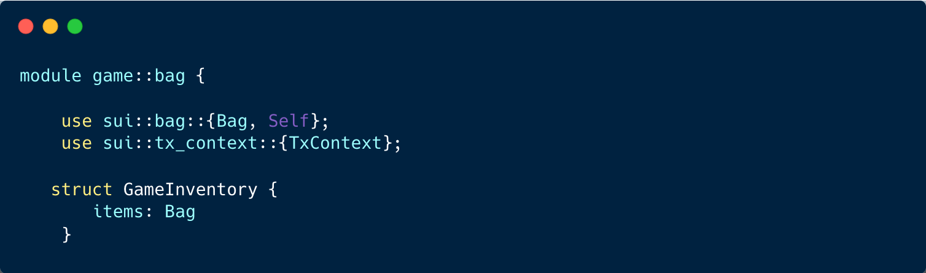
Code Sample
Notes:
Here's a breakdown of the code:
The module begins by importing necessary components from the Sui library, including the Bag collection and the TxContext for transaction context.
struct GameInventory { items: Bag } ： This line is declaring a structure named GameInventory that has a single field items of type Bag. This structure could represent an in-game inventory, where items is a container that holds the actual items in the inventory.

Slide 13
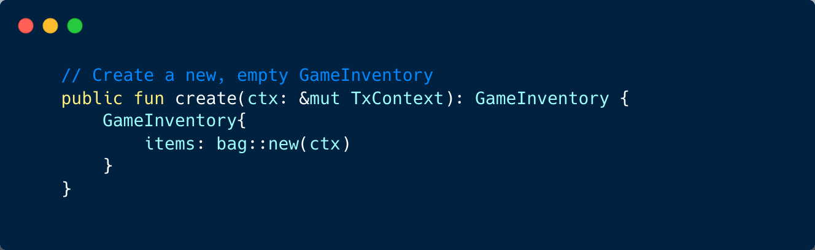
Code Sample
Notes:
The module provides a public function named "create" that creates a new, empty game inventory
. It takes a mutable reference to the transaction context ("ctx") and returns a GameInventory
instance with an empty Bag.

Slide 14
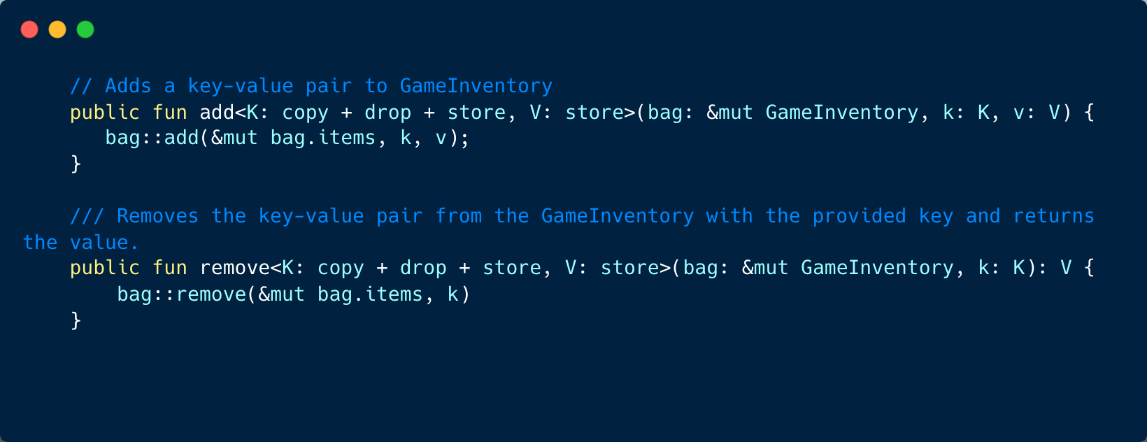
Code Sample
Notes:
These are two public functions, add and remove, defined in the game::bag module that interact with the GameInventory struct:
add Function:
public fun add<K: copy + drop + store, V: store>(bag: &mut GameInventory, k: K, v: V) { This is a public function named add that takes three arguments:
A mutable reference to a GameInventory object (bag),
A key of generic type K, which must satisfy the copy, drop, and store traits,
A value of generic type V, which must satisfy the store trait. The function does not return a value.
bag::add(&mut bag.items, k, v);: This is a call to the add function in the bag module, passing a mutable reference to the items field of the GameInventory, along with the key and value. This function adds the key-value pair to the GameInventory.
remove Function:
public fun remove<K: copy + drop + store, V: store>(bag: &mut GameInventory, k: K): V { This is a public function named remove that takes two arguments:
A mutable reference to a GameInventory object (bag),
A key of generic type K, which must satisfy the copy, drop, and store traits. The function returns a value of generic type V, which must satisfy the store trait.
bag::remove(&mut bag.items, k): This is a call to the remove function in the bag module, passing a mutable reference to the items field of the GameInventory, along with the key. This function removes the key-value pair from the GameInventory and returns the value associated with the key.
In summary, these functions provide the basic operations to add and remove items from a GameInventory in a game, treating the GameInventory as a key-value store.

Slide 15
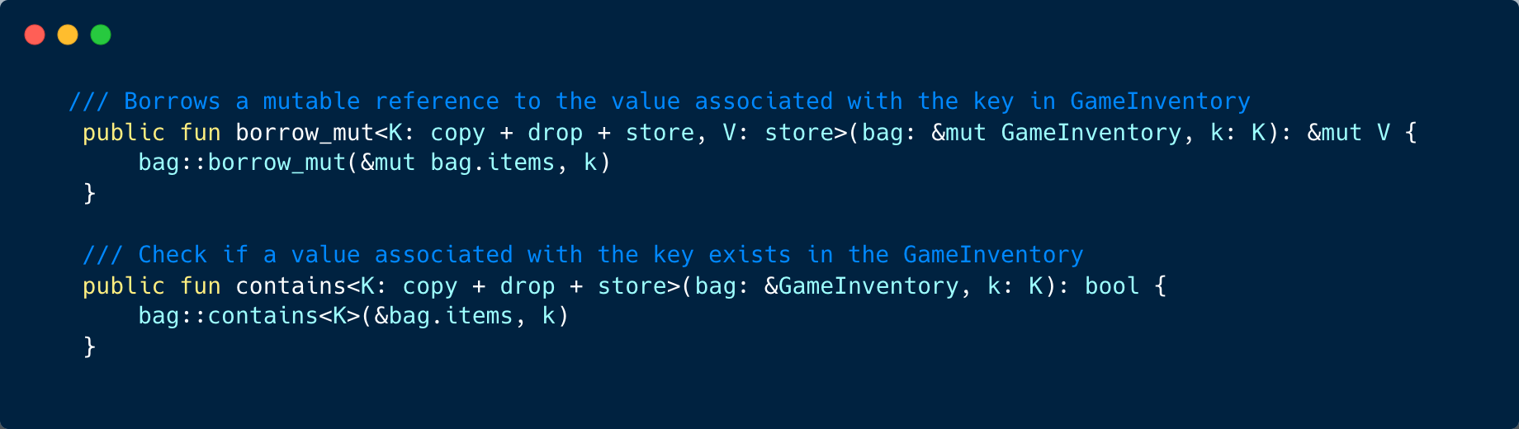
Code Sample
Notes:
These are two public functions, borrow_mut and contains, defined in the game::bag module that interact with the GameInventory struct:
borrow_mut Function:
public fun borrow_mut<K: copy + drop + store, V: store>(bag: &mut GameInventory, k: K): &mut V { This is a public function named borrow_mut that takes two arguments:
A mutable reference to a GameInventory object (bag),
A key of generic type K, which must satisfy the copy, drop, and store traits. The function returns a mutable reference to a value of generic type V, which must satisfy the store trait.
bag::borrow_mut(&mut bag.items, k): This is a call to the borrow_mut function in the bag module, passing a mutable reference to the items field of the GameInventory, along with the key. This function returns a mutable reference to the value associated with the key in the GameInventory.
contains Function:
public fun contains<K: copy + drop + store>(bag: &GameInventory, k: K): bool { This is a public function named contains that takes two arguments:
An immutable reference to a GameInventory object (bag),
A key of generic type K, which must satisfy the copy, drop, and store traits. The function returns a boolean value.
bag::contains<K>(&bag.items, k): This is a call to the contains function in the bag module, passing an immutable reference to the items field of the GameInventory, along with the key. This function checks if a key-value pair with the given key exists in the GameInventory and returns true if it exists, and false otherwise.
}: This ends the contains function.
In summary, these functions provide the operations to mutably borrow a value from a GameInventory and check if a key exists in a GameInventory in a game, treating the GameInventory as a key-value store.

Slide 16
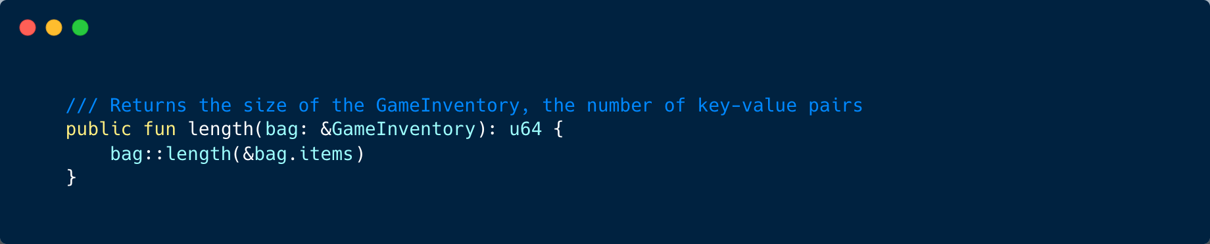
Code Sample
Notes:
The length function in the context of the game::bag module provides an operation to retrieve the size of the GameInventory, that is, the number of key-value pairs stored in it.

